Slide 1


Recommender System
For TV & Movies Micro Genres
Group 4

Slide 2
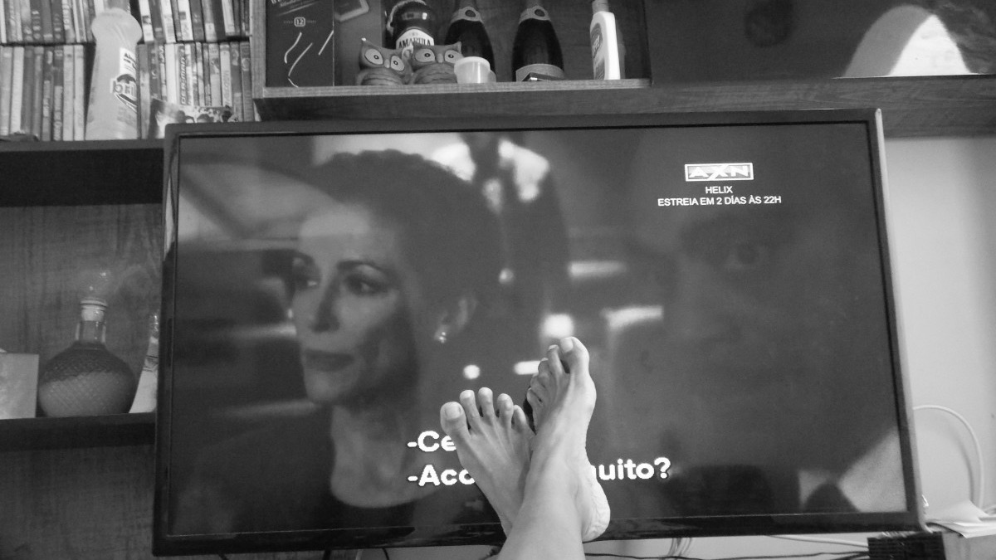

CONTENT
Requirements
Evaluation
Introduction
Description
Conclusion
02
04
Databased
Query process
Recommender system
Evaluations for our system
01
03
05
The system is based on users indicates which micro-genres of TV & Movies they prefer
How did them work
Our system can predict the micro-genres to the users well

Slide 3


INRODUCTION
The system is based on users indicates which micro-genres of TV & Movies they prefer

Slide 4

INTRODUCTION
RECOMMENDER SYSTEM
PROCESSING DATABASE
based on user indicates which micro-genres of TV & Movies they prefer
Use methods to structure the data for further usage
COLLECTING THE DATA
RECOMMENDER SYSTEM
Collecting the data comes from three or more databases
Content-based and collaborative filtering algorithm

Slide 5
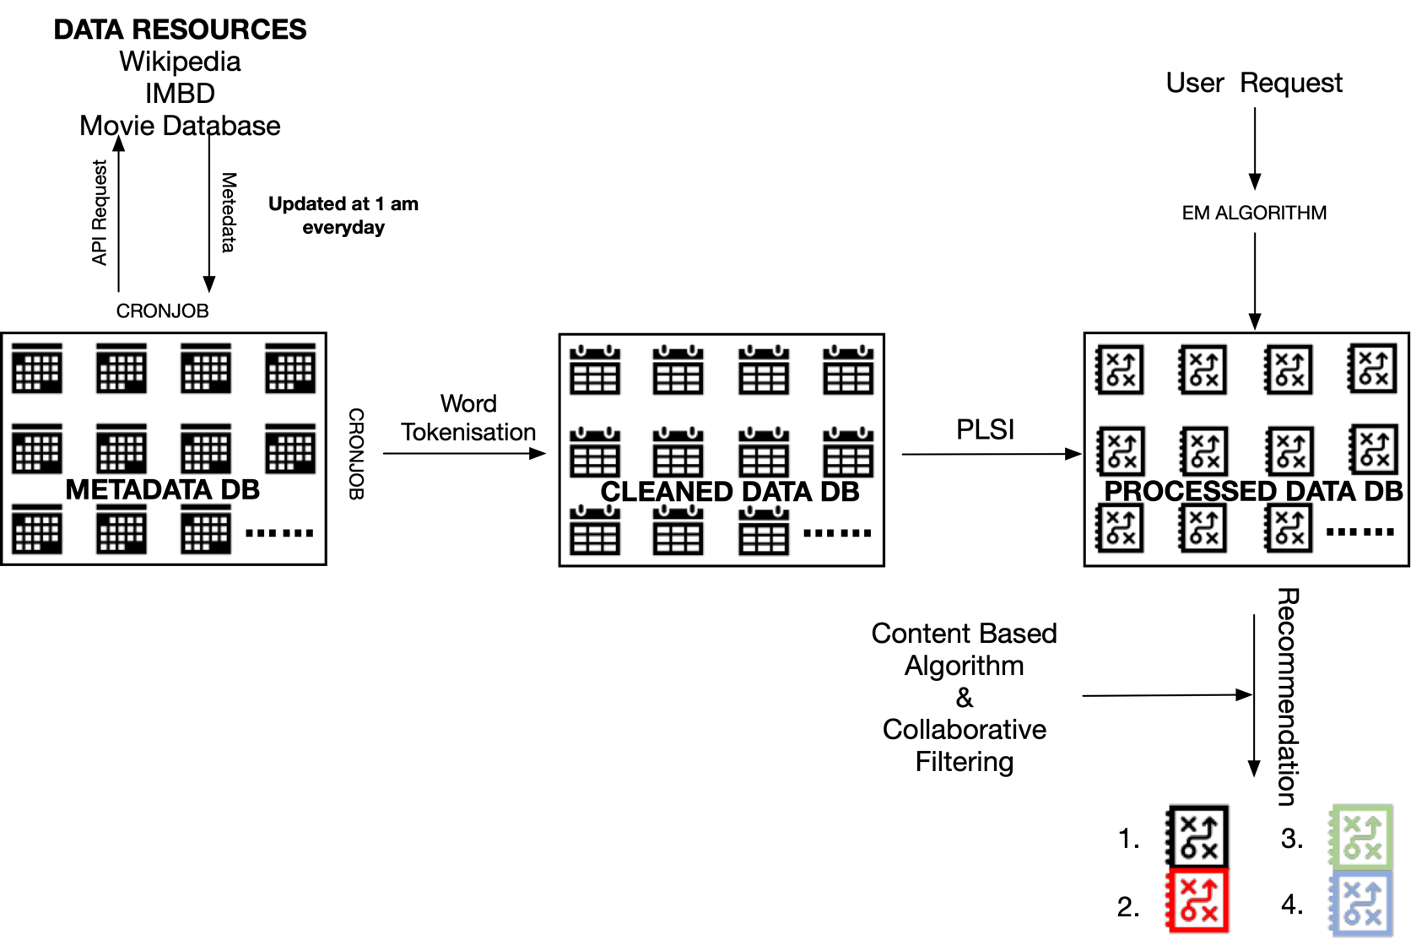

THE MODEL

Slide 7
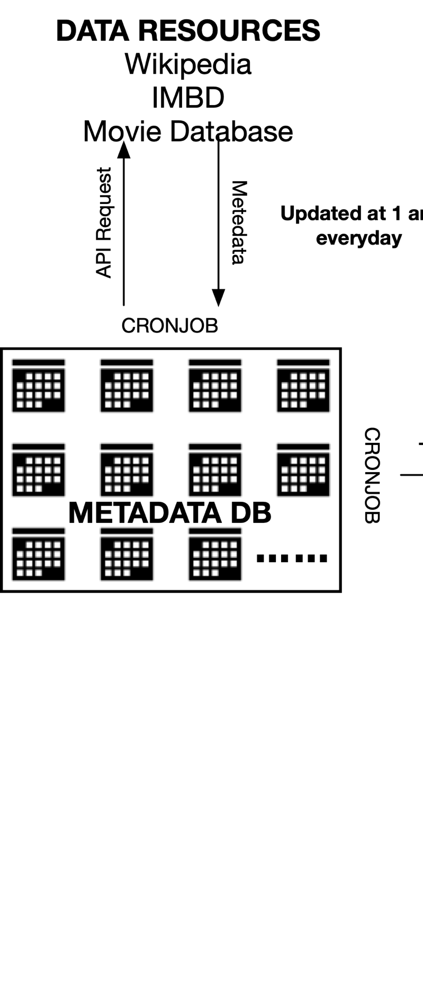

BUILD DATABASE

Slide 8

BUILD DATABASE
DATA COLLECTION
& PREPROCESSING
QUERY PROCESSING
RECCOMENDER FOR USER

Slide 10

DATABASE
MOVIE DATABASE
IMBD
WIKIPEDIA

Slide 11

TITLE
YEAR
RATING
ACTORS
GENERES
CREDING

Slide 12

TITLE
YEAR
RATING
ACTORS
……
GENERES
CREDING

Slide 13
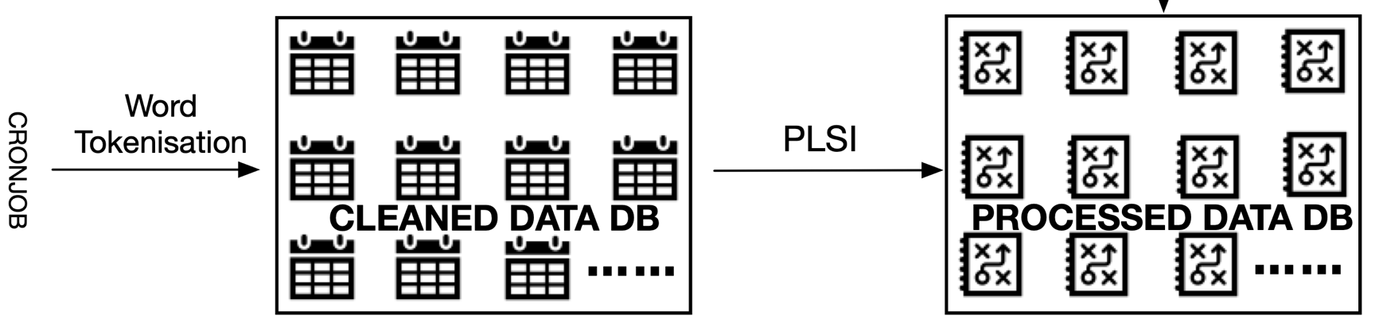
DATA CLEAN & PLSI

Slide 14



DATA CLEAN
PLSI
"Harry Potter is a series of fantasy novels written by British author J. K. Rowling. The novels chronicle the lives of a young wizard, Harry Potter, and his friends Hermione Granger and Ron Weasley, all of whom are students at Hogwarts School of Witchcraft and Wizardry."
“harry potter series fantasy novels written british author j k rowling novels chronicle lives young wizard harry potter friends hermione granger ron weasley students hogwarts school witchcraft and wizardry."
Replace
Replace
‘-’
‘ ’
‘-’
‘ ’
Words → vectors(w) to map their frequency
P(d) = ΣP(c|d)P(w|c)
Remove
Remove
Stop words:
‘about’ , ‘how’…
‘?’ ‘ ’ …
Stop words:
‘about’ , ‘how’…
‘?’ ‘ ’ …
Singular Vector Decomposition (SVD)
Change
Change
All words into lowercase
All words into lowercase
Expectation Maximisation (EM) algorithm
Split
Split words based on Tokenizer
Split
Split words based on Tokenizer
……
……
……

Slide 15
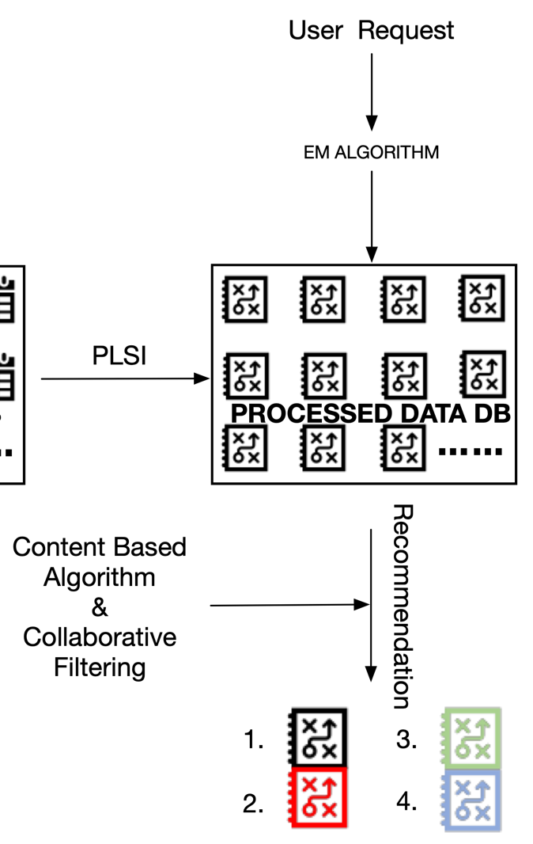


RECOMMENDATION

Slide 16








QUERY PROCESSING
Find the movies with the matching keywords
“action”
User Input
“action”
Associated with the initial query keywords
“violence”
“spies”
“suspense”

Slide 17







RECOMMENDATION
Based on popularity
Count the number of most rated and most
Similarly
User Input
Someone watches “Titanic" or ”James Cameron’s”
“Wolf of Wall Street" or "James Cameron's."
“action”
Basis of interactive content
Different user’s analysis and items analysis.

Slide 18

RECOMMENDATION
Fast and Furious
Fast and Furious
Friends
Friends
TWO
USER1
USER2
Game of Thrones
Game of Thrones
How to Train Your Dragon
Hellboy

Slide 20


EVALUATION
MongoDB database perform basis
Data mining on online database (IMDB)
EM algorithm for classification

Slide 22

CONCLUSION
COLLECTING THE DATA
PROCESSING DATABASE
RECOMMENDER SYSTEM
DATA CLEAN & PLSI
Content Based Algorithm
Collaborative Filtering

Slide 23
CONCLUSION

Slide 24


